Slide 1
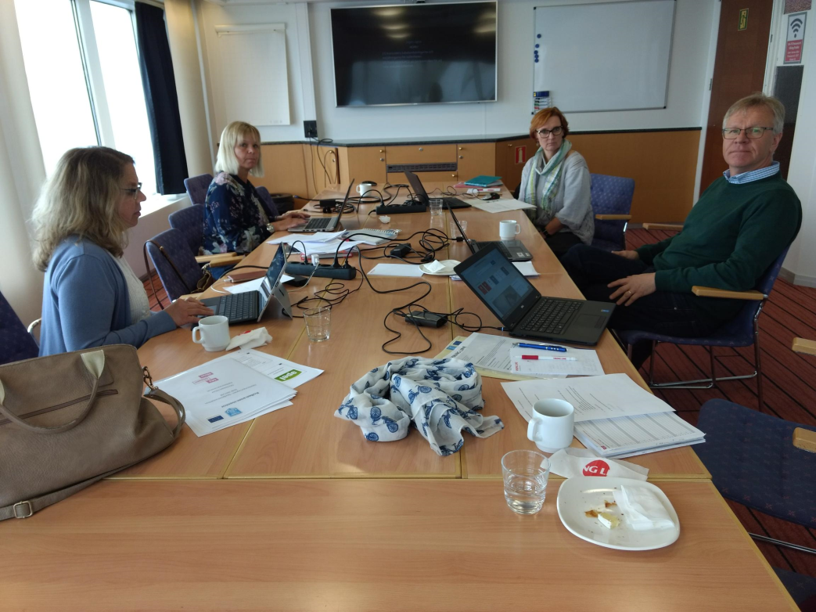
Effective Mentoring
Partners:Eskilstuna, Sweden and HAMK UAS , Finland

Slide 2
Partners:
S:t Eskils Gymnasium, Eskilstuna, Sweden
Target group: Newly arrived refugees, at risk of falling out of school
Häme University of Applied Sciences, Hämeenlinna, Finland (HAMK).
Target group in Finland: +15 years, at risk of falling out of school

Slide 3
Transnational collaboration objectives:
Creating an effective model of mentoring ready to be implemented in practice by transnational partners. Implementation of mentoring pilots 2017 -2019.
Creating a mentor-education for the mentors
Dissemination of good practices

Slide 4
Hämeenlinna pilots
Pilot in spring 2018 with a group of newly arrived refugees in basic education.
Individual and group mentoring (12 young people/students)
Mentor education and support for mentors during mentoring process (10 mentors)
Concentrating on students´ goals during mentoring process
Feedback gathered from students and mentors

Slide 5
Present pilots
Tavastia Vocational college:
Transition stage students 16 yrs ( graduaded from comprehensive school, but not in upper secondary school)
Three pilot groups
Mentors:
3rd year voctional college students from Tavastia
3rd year nurse students from HAMK
2nd year social service students
Forssa Vocational college:
1 pilot Transition stage students
Mentors: 3rd year voctional college and 3rd year nurse students from HAMK
HAMK University of Applied Sciences
Study path and career mentoring by 4th year students to 1st year students

Slide 6
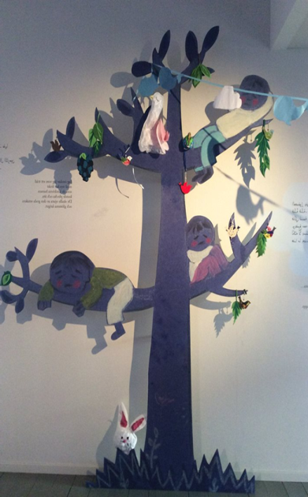
Hämeenlinna good practices
Individual level:
Personalized support
Clear goals based on youngsters´own needs during the mentoring process
Concentrating on every day living skills
Strengthening the motivation and commitment to studies
Building educational/study path
Career choices
Signed mentoring agreement
Defined period for co-operation

Slide 7
Hämeenlinna good practices
Mentor level:
Mentor education
Support during the mentoring process
Experience and skills for mentoring and guiding
Part of official studies
Working individually and in small groups
Learning experience also for mentors

Slide 8
School level:
Low threshold support for those at risk to drop out of school
Working in the small groups
Objectives for mentoring were defined partially with the teacher
Part of the school´s operating model, commitment of administration, teachers and student support services (study counselor, social worker, other support services)

Slide 9
More information
Hanna Naakka
Hanna.naakka@hamk.fi phone: +358400242869
Liisa Harakkamäki
Liisa.harakkamaki@hamk.fi phone: +358408307442
Kirsi Hentinen
Kirsi.hentinen@hamk.fi phone: +358505745108

Slide 10
Funding for the project
ESF Activity Line 4. Education, Competence and Lifelong Learning
ESF Special Target 9.1. Improving Services Supporting Transfer Phases and Educational Equality Municipal

Slide 11
KIITOS MIELENKIINNOSTA
Vi tackar !
Thank you !
ESR Toimintalina 9.1

