Slide 1
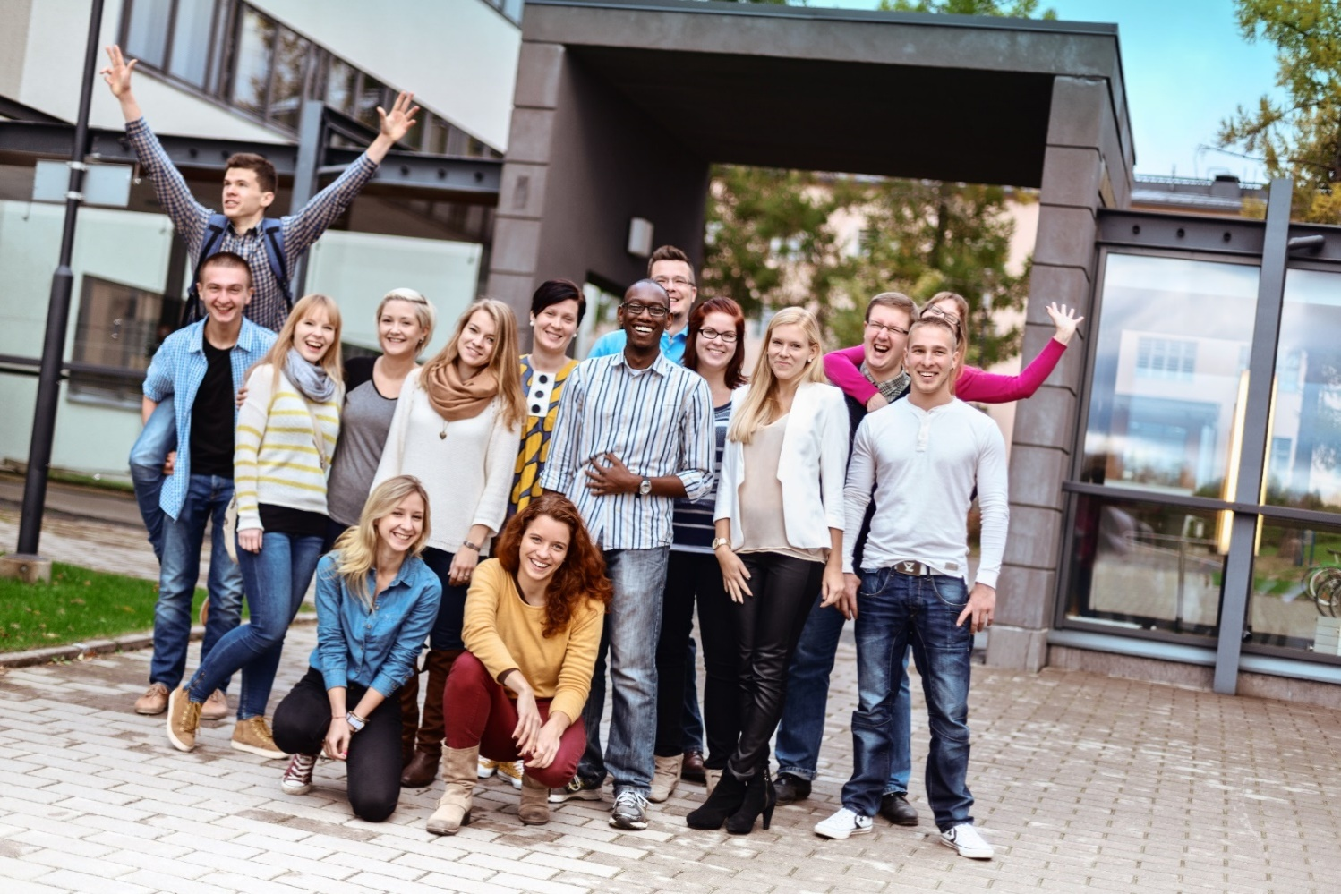
Häme University of Applied Sciences - HAMK

Slide 2
https://kaltura.hamk.fi/media/HAMK+-+Higher+education+with+a+professional+profile/0_8w0n4o7r

Slide 3
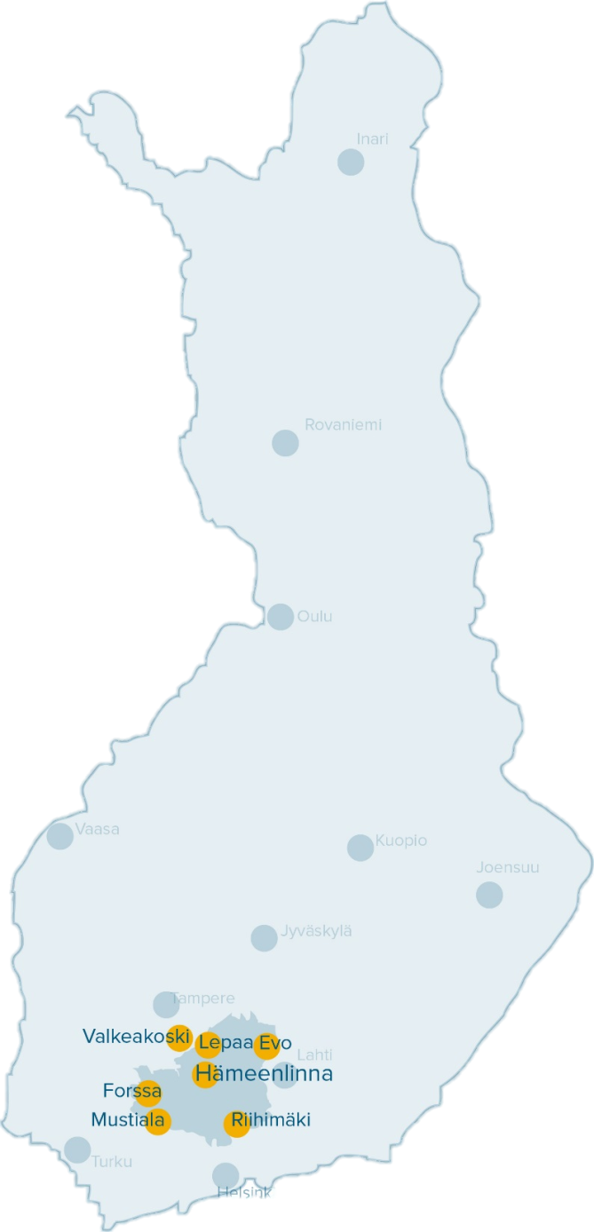
HAMK in Finland and in Europe
Situated centrally in the greater Helsinki metropolitan area of southern Finland at 7 campuses

Slide 4
HAMK – key figures
7000
Students
600
Foreign degree students
600
Staff
members
7
Campuses
20
Bachelor’s degree programmes in Finnish
4
Bachelor’s degree programmes in English
7
Master’s degree programmes in Finnish
1
Master’s degree programme in English
1
Professional Teacher Education
5
Schools
4
Research Units
100
partner universities abroad

Slide 5
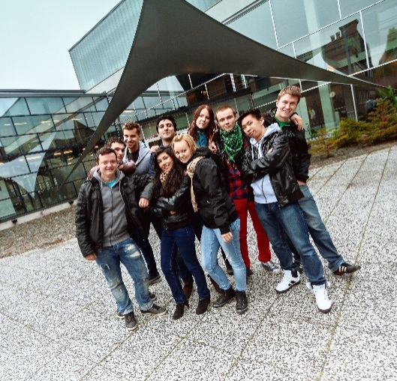
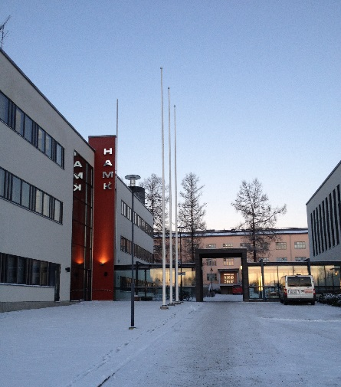
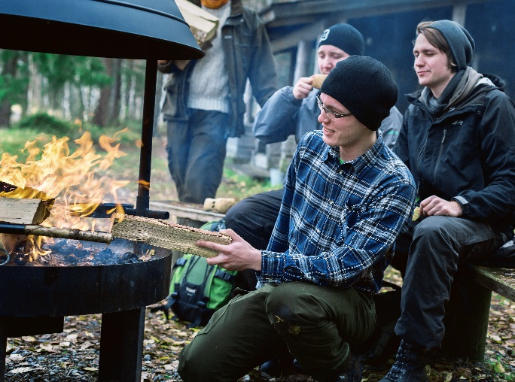
HAMK campuses
HAMK’s campuses are all situated within a 100 km radius in southern Finland.
Close by are the biggest cities in Finland - Helsinki, Tampere and Turku.

Slide 6
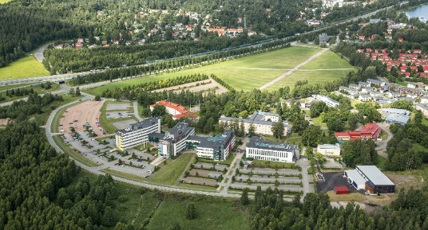
Hämeenlinna
Hämeenlinna University Centre at Visamäki is largest of its kind in Finland.
HAMK collaborates with educational institutions in the area: Tavastia Education Consortium, Kiipula Vocational College and upper secondary schools.
Hämeenlinna University Centre
Bachelor’s degree programmes: students: 4238
Biotechnology and Food Engineering staff: 404
Business Administration
Business Information Technology
Construction and Civil Engineering + Master’s degree programmes
Construction Management + School of Professional Construction Engineering (in English) Teacher Education
Design
Nursing
Public Health Nursing
Social Services

Slide 7
Schools
Bioeconomy
Entrepreneurship and Business
Technology
Wellbeing
Professional Teacher Education

Slide 8
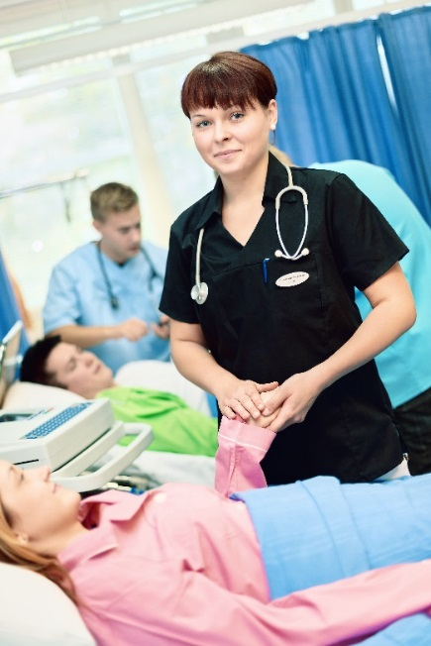
Wellbeing
The School of Wellbeing meets the needs of the wellbeing field.
The school has the following degree programmes:​
Nursing
Public Health Nursing
Social Services
Social and Health Care Development, Leadership and Management (Master-level)
Dean: Hanna Maijala​

Slide 9
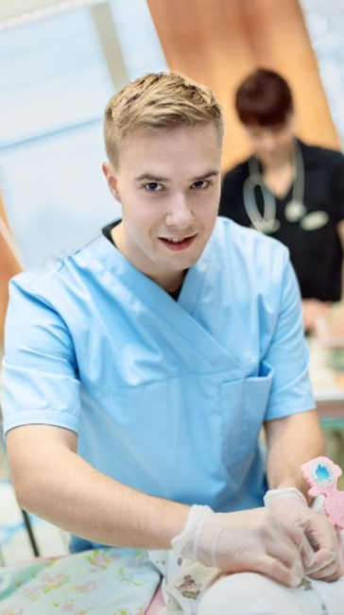
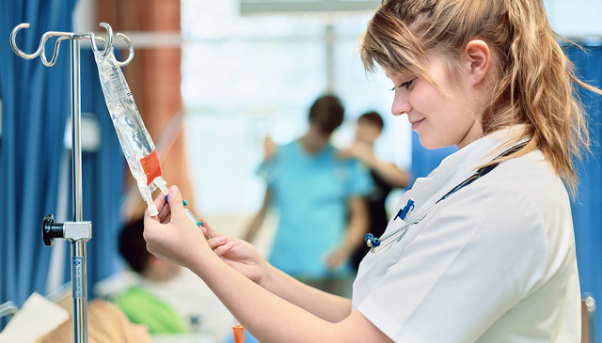
Fields of Studies and Bachelor’s Degree Programmes
Social Services, Health and Sports
Nursing
Public Health Nursing
Social Services

Slide 10
Master’s Degree Programmes
IN FINNISH
Promoting Wellbeing Through Culture and Art Activities
Social and Health Care Development and Management

Slide 11
Nursing Education in HAMK
Learning is an active process of a student
Learning occurs also outside the classrooms – informal learning
Collaboration and networking build the learning environment
- Teaching is not the only learning resource
In continuously changing world, life long learning is the key competence
– students need to learn to learn

Slide 12
Principles of Nursing Education in HAMK
Student centeredness: feedback and active role as developers
Competence orientated : intensive collaboration with health care services and other networks
Variation of pedagogical solution: PBL, virtual learning, project work
Variation of learning environments: SIM center, hospitals, multidisciplinary project groups, working with clients
Benchmarking good practices inside UAS and between HEIs

Slide 13
Nursing education in Finland
In Finland nurses receive their education at universities of applied sciences Registered nurses require 210 ects and lasts 3.5 years
Fulfills EU requirements (EU directives)

Slide 14
Nursing education requirements according to EU Directives
Practical studies:
Medical nursing
Surgical nursing
Child care and pediatric nursing
Maternity care
Mental health and psychiatric nursing
Elderly care and geriatric nursing
Theoretical studies:
Nursing ethics
Medical and surgical nursing
Child care and pediatric nursing
Maternity care
Mental health and psychiatric nursing
Elderly care and geriatric nursing
Natural and social sciences

Slide 15
Nursing education in HAMK
Seven modules for core competences, 15 ects each
Two modules of profile studies 15 + 15 ects
Practical studies are 75 ects + 15 ects 90 ects
Length of the practical studies in clinical placements is 5- 7 weeks
The aim is to stengthen practical skills as well as theoretical understanding
The focus is on growth and development of professional identity
Students are in active role and able to take part in nursing of the patients
Each student has a nurse mentor on the ward as a work pair

Slide 16
HAMK SIMCENTER AINOLA
The main idea is to focus in issues related to patient care; technical skills and non-technical skills
The simulation environment SimCenter Ainola can be utilised in many ways in bachelor level education and in continuing education
Nursing and social service students
Many external partners: Feevale University, in Brazil, Finnish Defece Forces, in specific NATO simulations, Kanta-Häme Central Hospital (both Hämeenlinna and Riihimäki units) and Hämeenlinna Health Services - department

Slide 17
EQUIPMENTS
SimCenter Ainola has a SimMan 3G patient simulator
In addition center is equipped with ADL-simulator and junior simulator
Modern av-system
Also possibility to take simulation “out”

Slide 18
WHERE simulation is used?
With undergraduate nursing students we simulate e.g. in these subjects:
basics of nursing
medical and surgical nursing
ethics of nursing
health promotion
mental health nursing
acute nursing
pediatric nursing
leadership studies /team work
first aid
In supplement education the sexual advicer education uses simulation too

Slide 19
With non-technical skills the students learn how to:
handle the situation (planning, pointing out the recourses, etc)
team work skills (collaboration, sharing information, communication, etc.)
situational awareness (making notices and preparing, understanding, etc.)
decision making (different option, risks, choose proper option, re-estimation, etc.)
leadership
→ All these point out in the end for patient safety

Slide 20
OUTCOMES
Have proven to create good learning outcomes
The learning experiences have proven to be pleasant and at high quality for both undergraduate students, experienced nurses and medical teams
Simulation has enhanced co-operation skills of medical teams in the real life situations of patient care

Slide 21
Customer-oriented applied research

Slide 22
Four research units
Sheet Metal Centre
sheet metal products and manufacturing
Professional Excellence
competence development and management
Bioeconomy
bioprocesses and sustainable development
Smart Services
digital technologies and service business development across sectors
Respond to both global and regional challenges.
Each research unit has its own research programmes with specified areas of expertise.
Research groups make good use of HAMK’s many different fields and combine expertise from these various fields.
Research environments offer a place to implement applied research.
Produce direct benefits for HAMK students and business and industry.
By combining research activities and teaching, the structure and content of education is improved.

Slide 23
International HAMK

Slide 24
International HAMK
All students are guaranteed opportunities to develop their international competence, which forms a part of the generic workplace competences.
E.g. mobility, double degrees, virtual mobility, courses offered in English, international R&D projects.
Staff mobility promotes the quality of education and RD activities and supports the international competence of students.
International HAMK has a significant impact on the internationalisation of the region’s enterprises and the community

Slide 25
International HAMK Partners
Over 100 partner universities in Europe, about 20 partner universities in Asia, America, Russia and Africa
Strategic partnerships:
Feevale University, Brazil
VIA University College, Denmark
HAMK has about 10 double degree partners which allows students to complete another degree abroad while studying at HAMK.

Slide 26
International HAMK Mobility 2017
167 outgoing students and trainees to 25 different countries
150 incoming students and trainees from 25 different countries
349 outgoing staff exchanges to 43 different countries
185 incoming staff exchanges from 24 different countries

Slide 27
Audited by FINEEC
In Finland, the Finnish Education Evaluation Centre (FINEEC) audits the quality systems in higher education. FINEEC conducted an audit of HAMK in 2016 and awarded the institution a quality label valid for six years starting on 26 August 2016.
In the previous audit of 2010, HAMK was the first higher education institution in Finland to receive the status ”advanced” which is the highest level of the quality assurance system.
The quality assurance system is based on the PDCA (Plan, Do, Check, Assess) model for the planning, implementation and assessment of activities and continuous development.

Slide 28
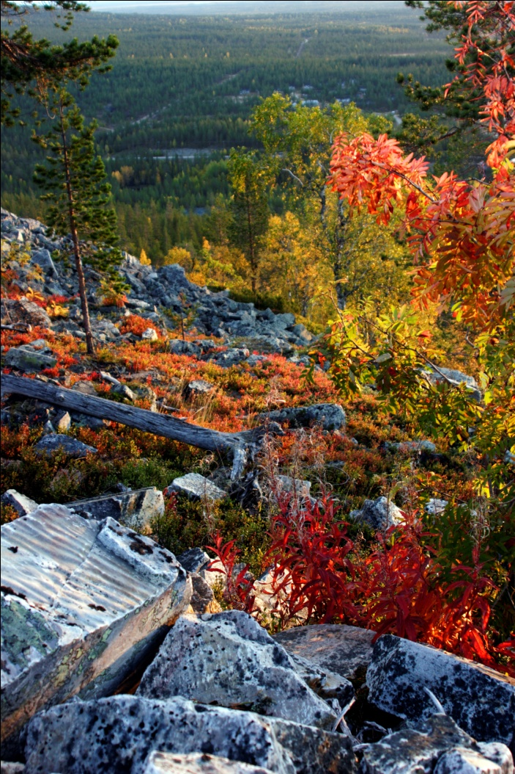
Finland in a Nutshell
Population | 5.4 million
Average population density | 18.1 inhabitants/km²
Total area | 338,440 km²
Capital | Helsinki (ca 560,000 inhabitants)
Official languages | Finnish (88.9%), Swedish (5.3%)
Form of government | Parliamentary republic since 1917
President | Mr Sauli Niinistö
Member of EU | Since 1995
Literacy level | 100%
Religion | Evangelic-Lutheran 73.8%, Orthodox 1.1%
Currency | Euro

Slide 29
Häme University of Applied Sciences Visamäentie 35 A 13100 Hämeenlinna FINLAND
tel: +358 3 6461
Email: hamk@hamk.fi

