Slide 1


One-Stop Guidance Center
A low threshold service center for young people aged 15 to 29 yrs

Slide 5


The Presentation of Ohjaamo Helsinki
https://www.youtube.com/watch?v=vVNkdwz1nAM

Slide 6
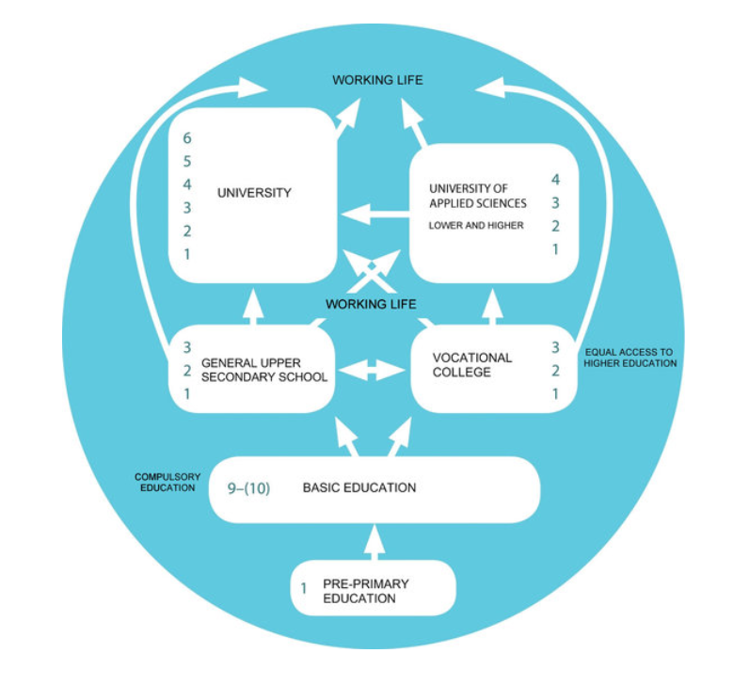
The Finnish education system

Slide 7

Vocational Teacher Education in Finland
Vocational teacher education is intended for applicants who work or intend to work as a teacher at universities of applied sciences and institutions of vocational education.
¨The education offers a general pedagogical qualification for teaching at all educational levels
The aim of vocational teacher education is to provide the students with
the knowledge and skills needed in the guidance of the learning process of individual students
the competencies to advance in their own teaching area, taking into account the development of working life and professions.
The extent of vocational teacher education is 60 ECTS credit points. It includes studies in the basics of educational sciences, vocational pedagogy, and a teaching practice, among other studies.

Slide 8

Vocational Special Needs Teacher Education
The Vocational Special Needs Teacher Education is a post-graduate programme for teachers. This programme of 60 ECTS credits is aimed at teachers wishing to specialise in the broad field of special education.
The programme is designed for teachers and trainers who already work within special education or who are intending to move to this field. Most of our students continue working while their studies. The completion of the programme takes around 1-2 years, after which you will be qualified to work as a special needs teacher within vocational and training organisations.

Slide 9

Vocational Career Guidance Counsellor Educations
a study programme for teachers who aim to work as guidance counsellors in universities of applied sciences or at vocational institutions/colleges.
with Master’s degree, this programme qualifies you for guidance counsellor’s positions in comprehensive school and upper secondary school as well.
60 ECTS credit points
Guidance and counselling in vocational education gives holistic support for students at different stages of study. The aim is to increase the wellbeing of students, prevent drop-out, enhance employment and promote enrollment to further education.

